Slide 1

Generative Model for
Recommendation Improvements:
A Progress Update
Team 4, Presentation 1, 07/19/2021

Slide 2
Project Collaborators
Team Members:
Muharrem Baris Otus
Samanwita Samal
Lauren Snider
Sijie Tang
Miao Zhang
Ahmed Zytoon
Mentors from C.H. Robinson:
Natalie Heer, Senior Data Scientist
Michael Chmutov, Data Scientist
Bethany Stai, Data Scientist

Slide 3
Content
Problem and goal
Data visualization
Modeling
Future plan

Slide 4
Background on Problem
Yellow or Red
Recommender
System
Account Team
Customer
(Shipper)
Places Order
Green
Acceptance
Rejection
CustomerWithdraws
Notes:
Some greens get rejected too right?

Slide 5
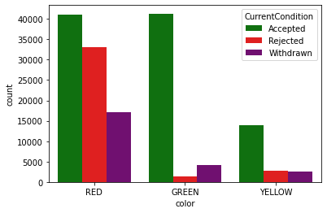
Background on Problem
Notes:
What would this look like if the Recommender System was working well?

Slide 6
The Problem
C.H. Robinson would like to improve current Recommender System and need a way to test improvements to Recommender System
An understanding of the structural relationships between decision factors would be helpful

Slide 7
Our Goal
Business Impact
To construct a generative parametric algorithm that can produce synthetic data to evaluate improvements to the Recommender System
This model will give an explicit understanding of how different decision factors interact
By improving the Recommender System, C.H. Robinson can process more orders and make more reliable decisions
Our model will help the Data Science team know whether their proposed changes to Recommender System are effective

Slide 8
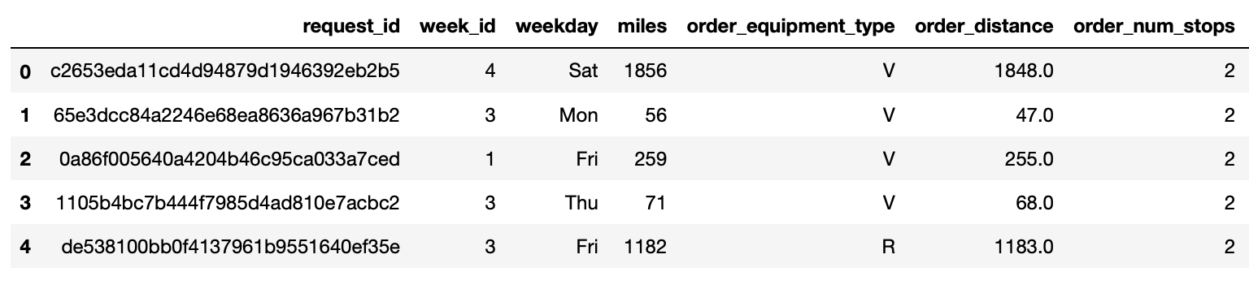
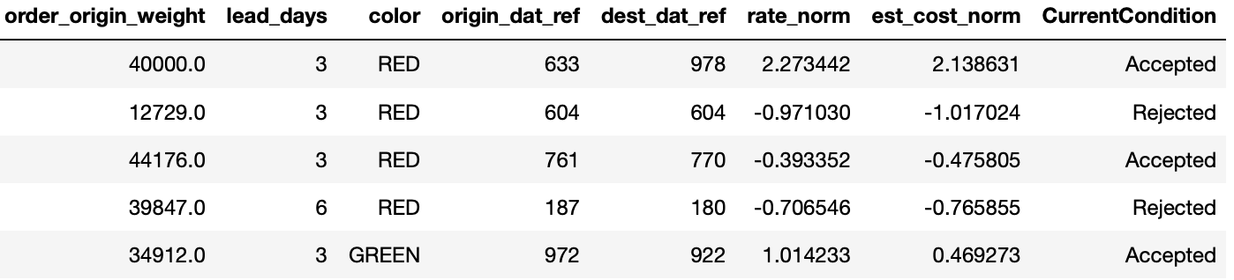
First look at our data

Slide 9
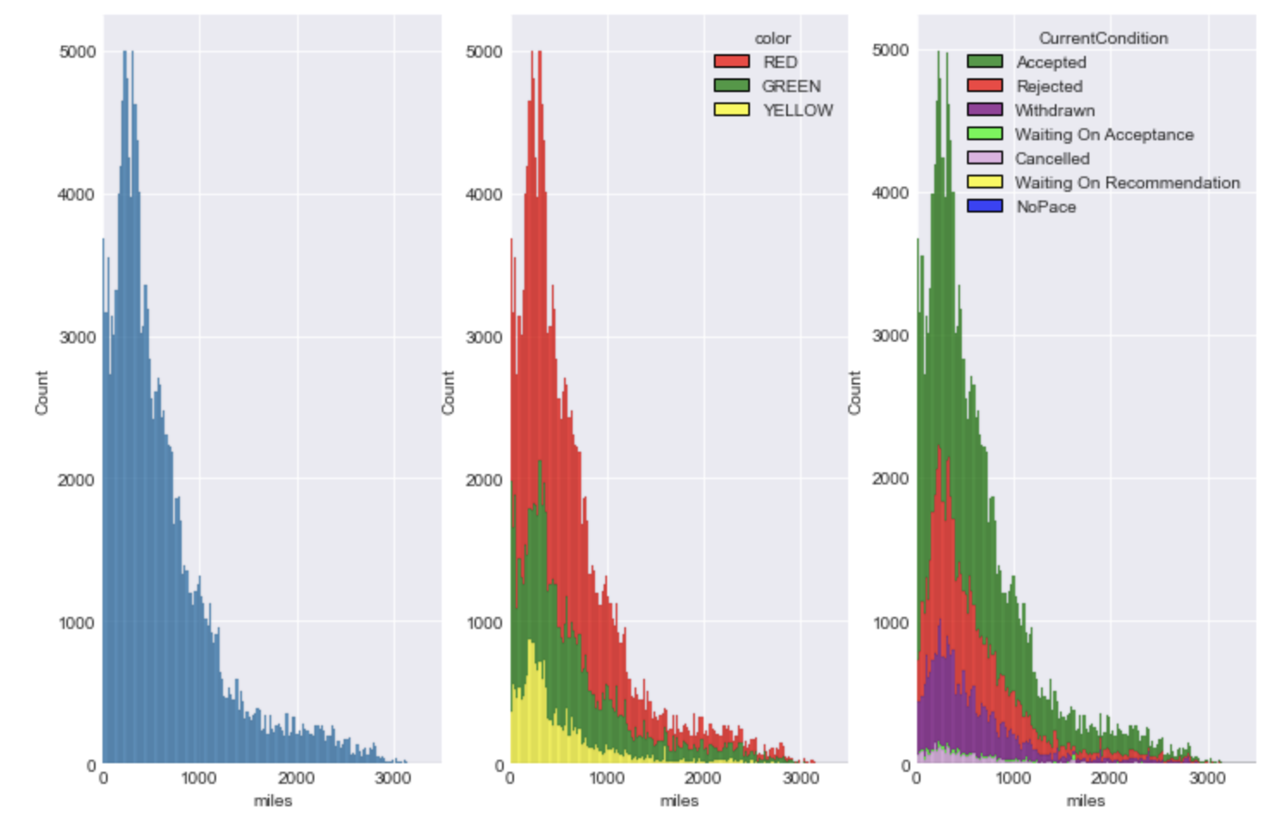
Distribution of miles
Red: rejected
Green: accepted
Yellow: waiting
The distance frequently requested in orders are below 500 miles.

Slide 10
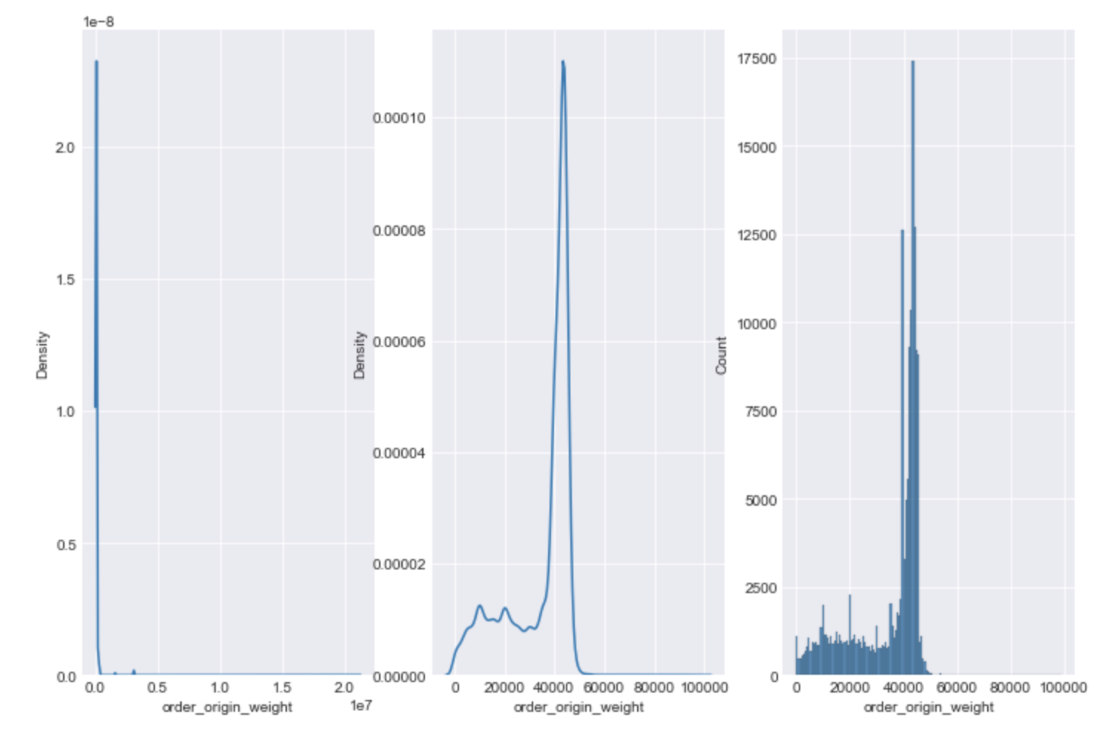
Distribution of order_origin_weight
The x axis in the second and third plots are [0, 100000].
Most of the weight is below 50000 since customers want to make the best use of the trucks.
Notes:
shorter , but heavier
An 18-wheeler can legally weigh as much as 80,000 pounds, and it weigh around 25,000 pounds itself. So we are not able to simply see it as a normal distribution.

Slide 11
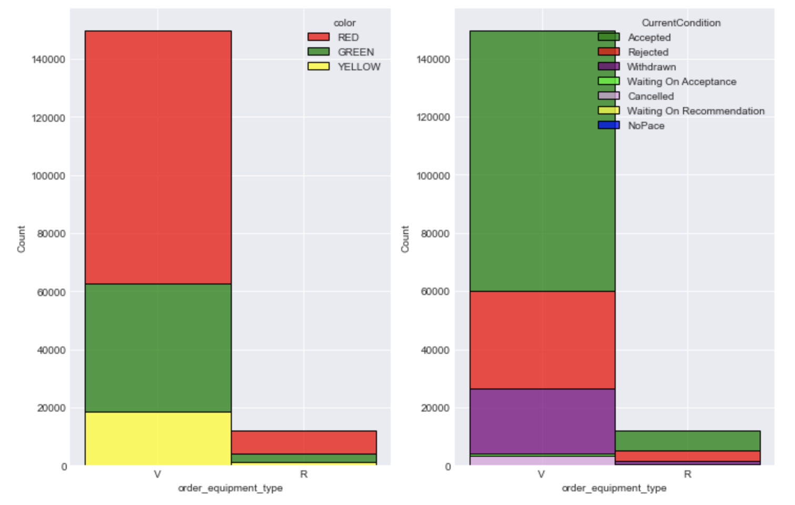
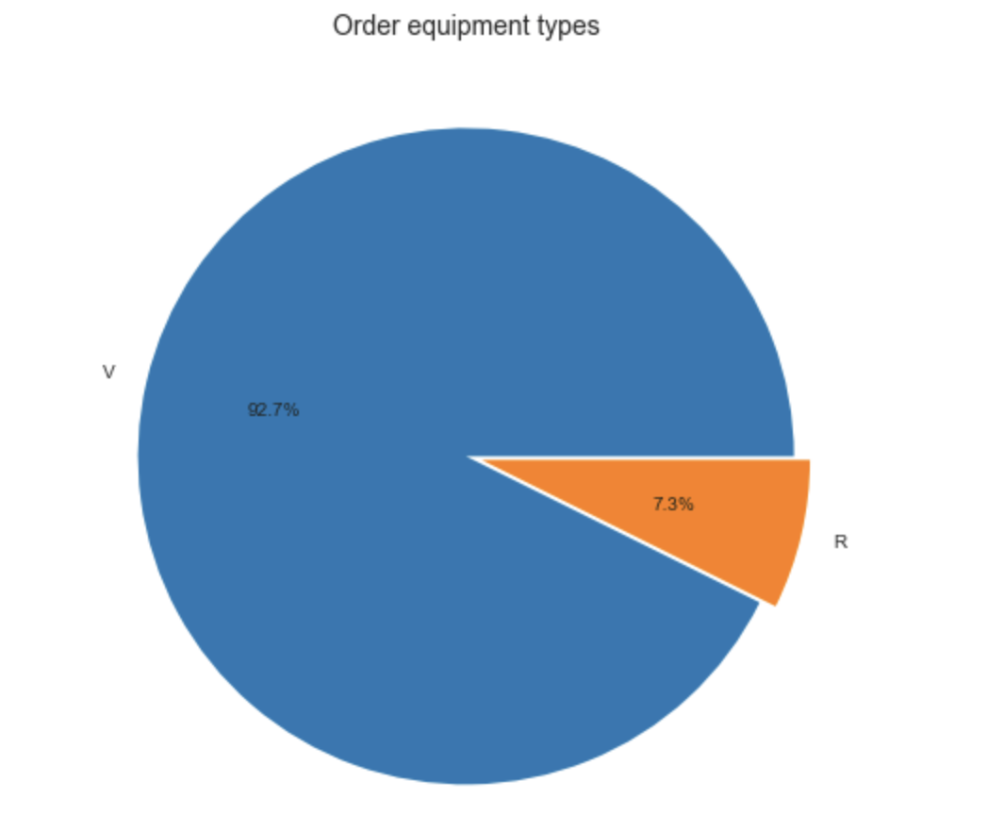
Percentages in order_equipment_types
Notes:
V: van R: reefer(refrigerated truck)

Slide 12
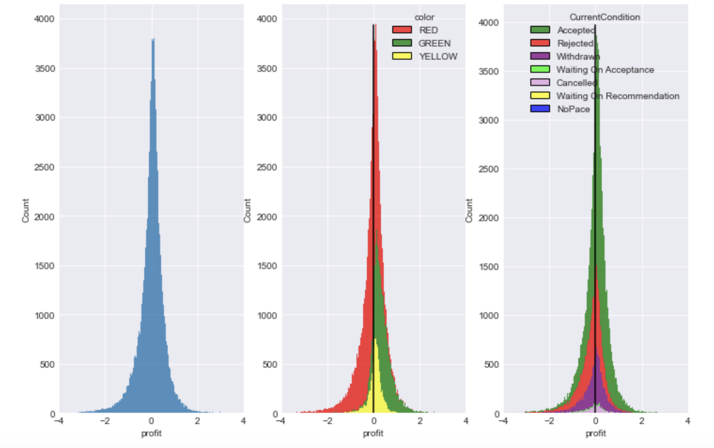
How does profit influence the decisions?
Profit = rate_norm - est_cost_norm
Notes:
Indication of profit

Slide 13
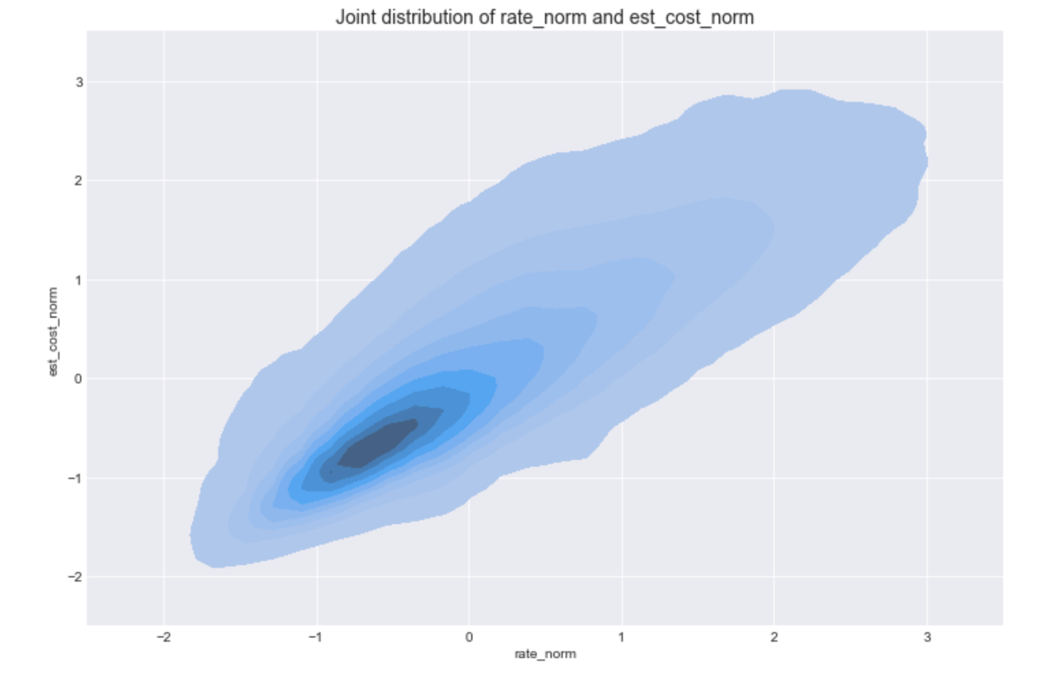
Bivariate plot of rate_norm and est_cost_norm
Notes:
Each point on the plot shows the rate_norm and est_cost_norm for a single order

Slide 14
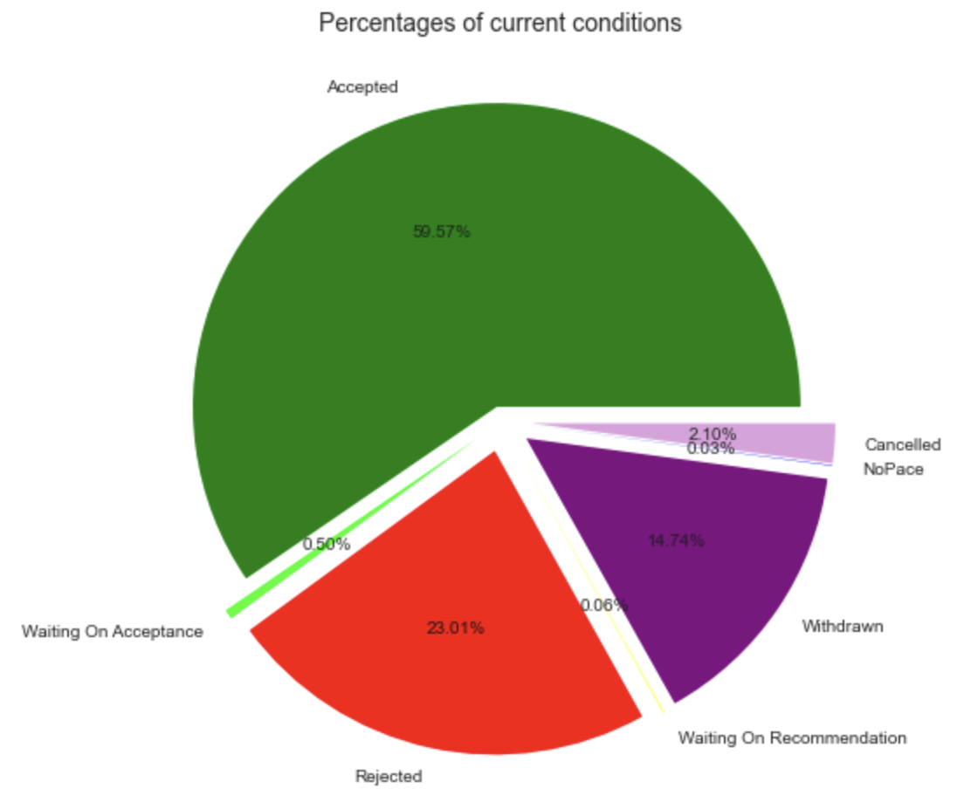
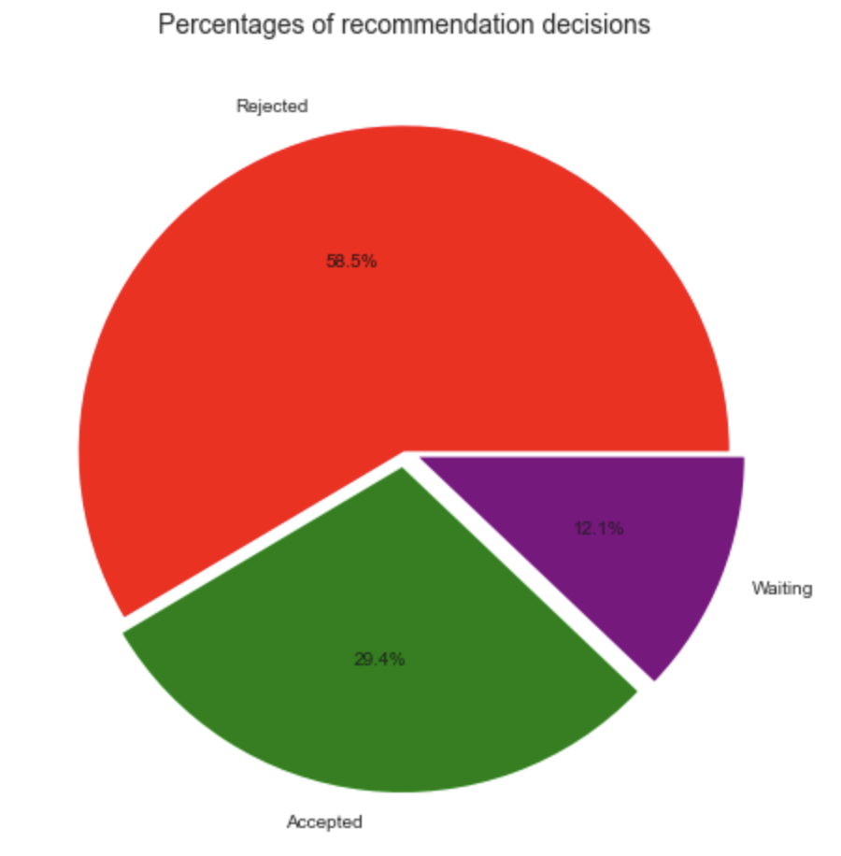
Decisions changed from recommendation system to account team

Slide 15
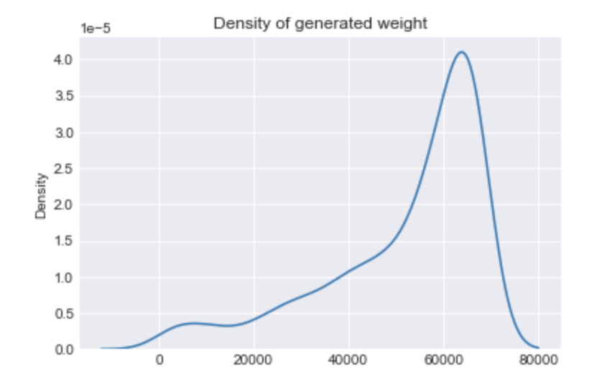
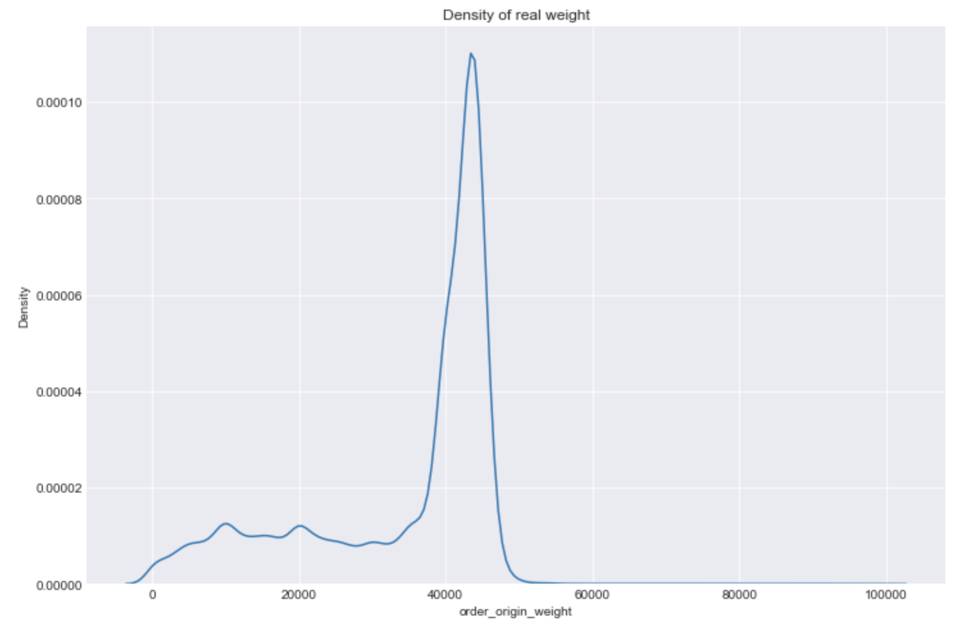
Data generation for one column
Assumption: order weight is independent from other columns.
Model: Y = 0.00277 - 0.00056 * X^2 + 0.00094 * X, where X ~ N(0, 1).

Slide 16
Time
(lead_days, week_id, weekday)
Order Information
(order_origin_weight, miles, order_num_stops, order_equipment_type)
Location
(origin_dat_ref, dest_dat_ref)
Rate
(rate_norm)
Estimated Cost
(est_cost_norm)
Recommender Outcome
(color)
Final Decision
(CurrentCondition)

Slide 17
Future work
Potential approach for generating synthetic data:
Bayesian networks (compute joint probability of the network using the dependency conditions)
Potential algorithms to test the model:
1. Generative adversarial networks
2. Support vector machines

Slide 18
Thank you for your attention.

Slide 20
lead_days
week_id
weekday
order_origin_weighte)
order_num_stops)
miles
order_equipment_type
Rate
(rate_norm)
Estimated Cost
(est_cost_norm)
Recommender Outcome
(color)

Slide 21
Simple BBN for color and CurrentCondition
Rate
(rate_norm)
Estimated Cost
(est_cost_norm)
Recommender Outcome
(color)
Final Decision
(CurrentCondition)

